Slide 1

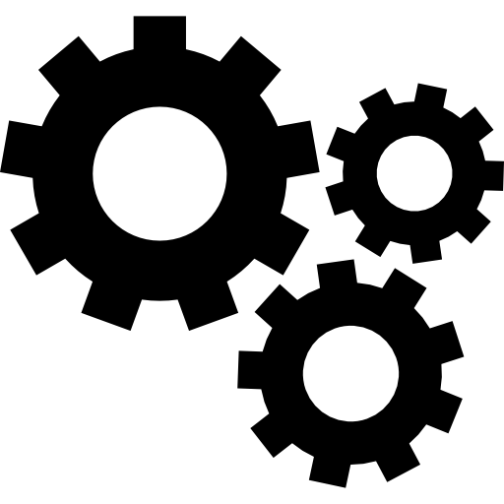



WELCOME
working 2
about
conclusion
Introduction
about
working 1
topic
materials
conclusion
Significance

Slide 2
ARIES PROJECT
LINE FOLLOWING DRONE (WITH LANDING)
working 2
about
conclusion
about
working 1
Introduction
topic
materials
conclusion
Significance
Mentor : Ritik Raj
Team Members :-
Himanshi || Kapil Bishnoi || Harshwardhan Raghu || Siddhant Shekhar || Shubham

Slide 3
Overview
-> This project aims to design a Line-tracking algorithm through Vision-based control with image processing techniques.
-> A significant advantage that characterizes this technique is the auto-code generation, which allows us to automatically translate the blocks of the model built through Simulink into a C-code executable by the hardware, instead of writing it manually.
-> This project aims to make a drone follow a line of a specific color(here red) and land at the end of it on a circle while remaining stable and following path as precisely as possible.
-> The environment used to design and develop the control system is MATLAB, with
Simulink and their add-on toolboxes like Aerospace blockset, image processing,
computer vision, and Hardware support package for Parrot mini drone.
-> Firstly, the preliminary goal is the accomplishment of the stabilization of flight maneuvers through a suitable control system architecture and PID controllers tuning.
Then, the Flight Control System design proceeds with Image processing and Path planning subsystems design.
-> The line-tracking algorithm implementations is based on the analysis of the pixels of the image acquired from the downward-facing camera and elaboration through image processing techniques like color thresholding and edge detection.
-> The path planning logic was implemented through Stateflow, which is an add-on tool of Simulink, useful for State machines design.
conclusion
about
conclusion
project
Significance
Introduction

Slide 4
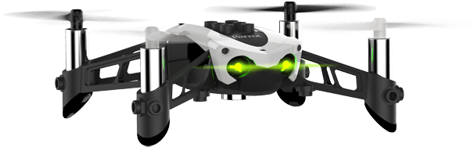
Application of Line following Drone :
Line/path following is a relevant application problem within the Unmanned Aerial Vehicle (UAV) field.
For instance, in precision agriculture scenarios having good path following algorithms is a fundamental requirement to preserve high productivity rates and plant growth.
In civilian applications, monitoring of power lines can be encoded as a path following problem between several target regions that need to be inspected. Whatever the field of application is, drones have to follow a path to accomplish the mission specifications safely and successfully.
about
conclusion
project
conclusion
Introduction
Significance

Slide 5
Components of Drone
Control System
Image processing Unit
conclusion
about
What is IPR
conclusion
project
Significance

Slide 6
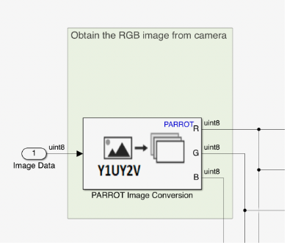
Image Processing Unit
Parrot Image Conversion Block:This block converts an image from Y1UY2V format obtained from the camera, to either YUV or RGB format. The block separates the color components and provides them as the output.
conclusion
about
What is IPR
conclusion
project
Significance
Image Binarization System:
Image Binarization is the conversion of a document image into bi-level
document image.

Slide 7
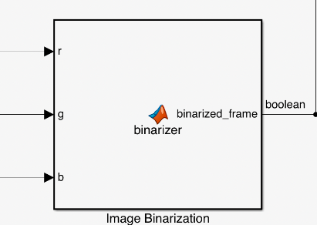
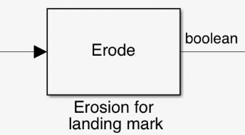
Image Binarizer MATLAB Function(ss): The MATLAB function computes a binarized frame starting from a frame expressed in the RGB file format. Inputs are red, green, and blue channel frame and output is the binarized frame. Parameters are:
(i) G_B_GAIN
(ii) BINARIZER_THRESHOLD
conclusion
Introduction
about
conclusion
project
Significance
Erosion : The Erosion block slides the neighborhood or structuring element over an image, finds the local minima, and creates the output matrix from these minimum values. If the neighborhood or structuring element has a center element, the block places the minima there.

Slide 8
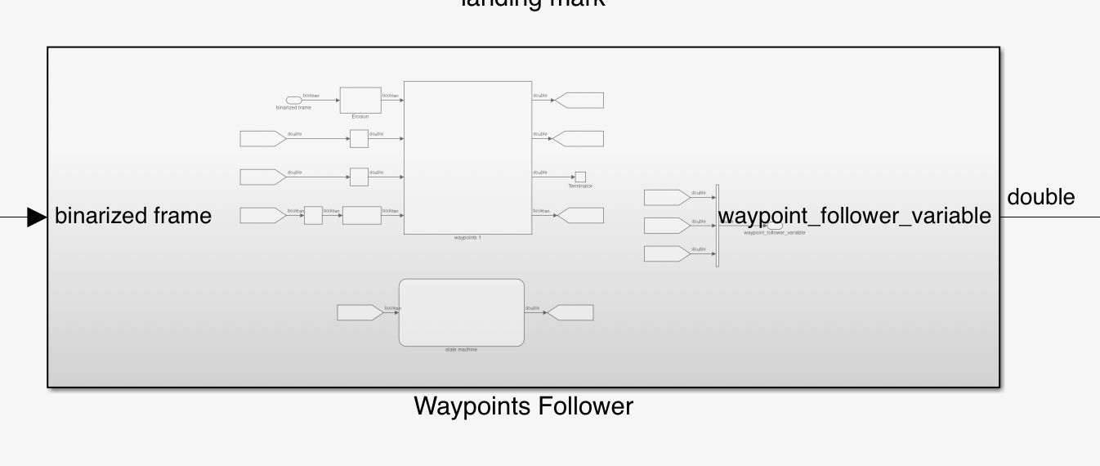
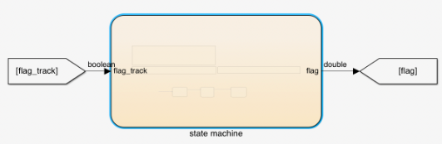
Waypoint Follower:
In this vision based path following algorithm, it starts selecting a target position ahead of the drone which has to be reached typically on the path.
conclusion
What is IPR
topic
conclusion
about
Significance
State Machine:
State machine gives whether the drone is over the lane/track by making the FLAG variable either 0 or 1. The input flag-track raises when the track is detected from the image processing system.

Slide 9
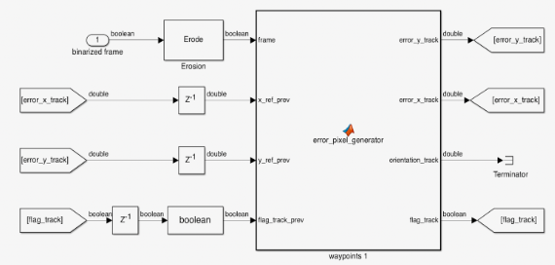
Error-pixel generator MATLAB function(ss):
The MATLAB function computes the error along the x and y-axis between the drone COG(Center of Gravity) and the point of the track. This error is later used by the path planner for the lane tracking.
conclusion
What is IPR
conclusion
topic
Significance
about

Slide 10
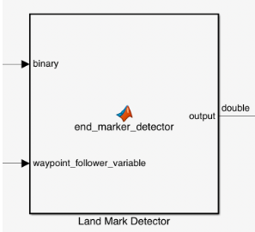
Land Marker Detector MATLAB Function (ss):
The MATLAB function computes the errors along the x- and y-axis between the drone COG and the middle of the lane. The end marker is detected by using a disk kernel. This function is active only when the drone has arrived at the end of the path.
conclusion
about
What is IPR
conclusion
topic
Significance

Slide 11
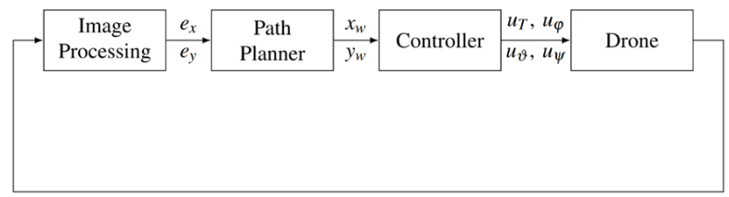
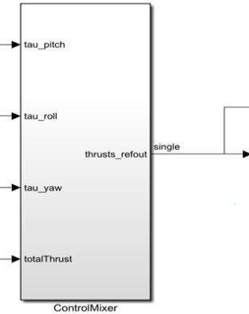
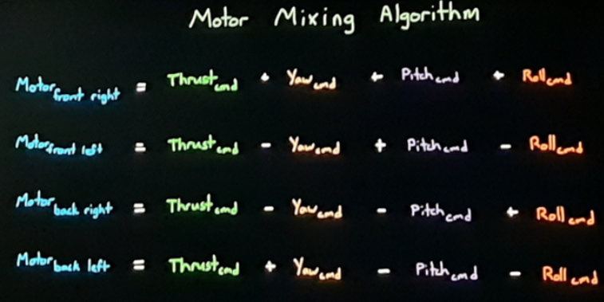
Control System :
The basic idea of a control system is to figure out how to generate the appropriate actuated signal, the input, so that our system will produce the desired controlled variable, the output.
conclusion
Intriduction
conclusion
topic
Significance
about
Motor mixing Algorithm :

Slide 12
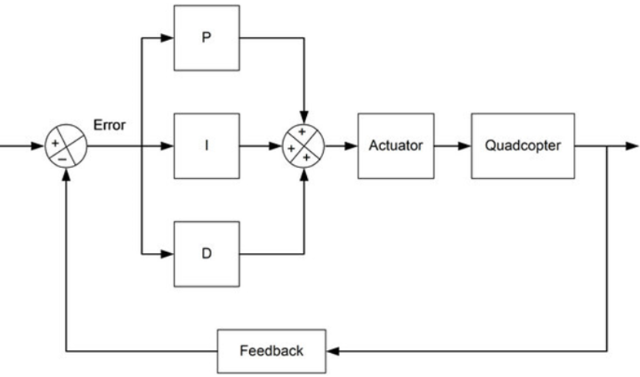
PID Controller
PID stands for Proportional, Integral, Derivative, it’s part of a flight controller software that reads the data from sensors and calculates how fast the motors should spin in order to retain the desired rotation speed of the aircraft.
The goal of the PID controller is to correct the “error“, the difference between a measured value (gyro sensor measurement), and a desired set-point (the desired rotation speed). The “error” can be minimized by adjusting the control inputs in every loop, which is the speed of the motors.
conclusion
Intriduction
conclusion
topic
Significance
about

Slide 13
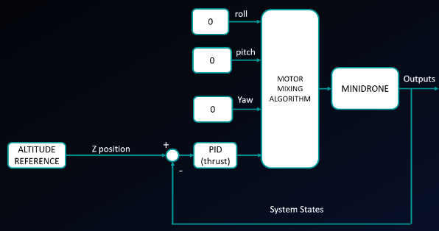
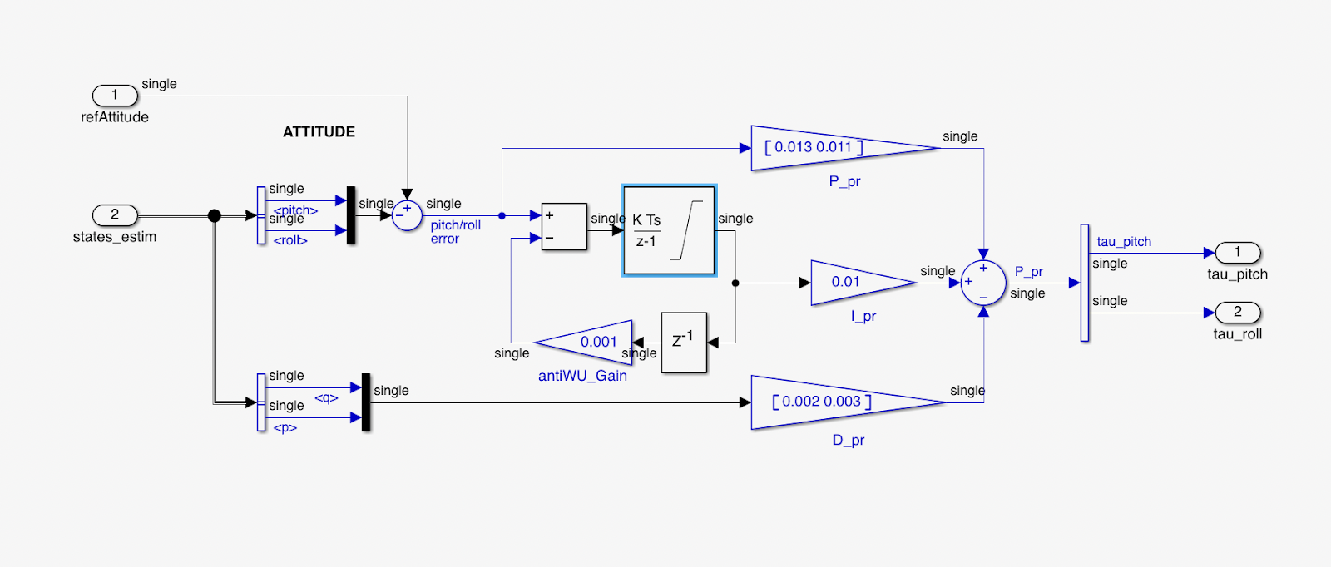
Example:
Altitude Controller Tuning
conclusion
Intriduction
conclusion
topic
Significance
Control System simplification for altitude controller tuning
about
Linearized control System used for altitude controller tuning

Slide 14
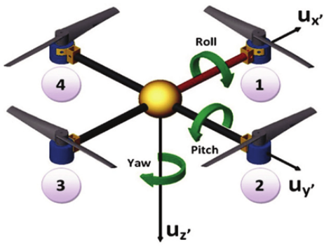
Different Sensors used in drone
-Accelerometer -Barometer
-Gyro Sensor -Magnetometer
Different Motion in drone:
Any type of motion can be described as combination of these three following motions
conclusion
Intriduction
conclusion
topic
Significance
about

Slide 15
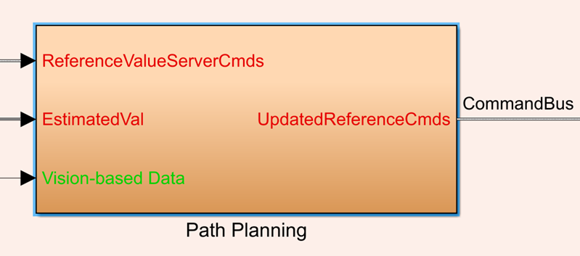
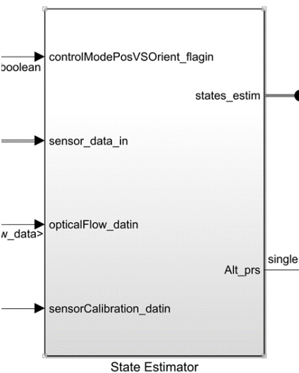
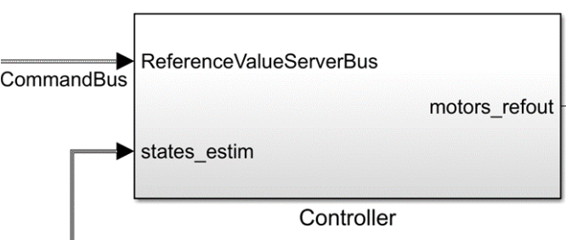
Important Blocks used in Control System part:-
conclusion
Intriduction
conclusion
topic
Significance
about

Slide 16
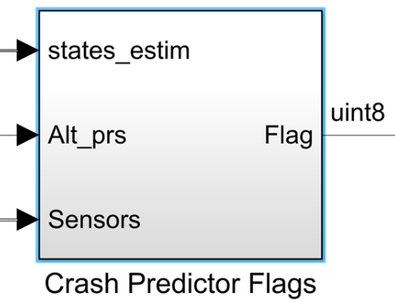
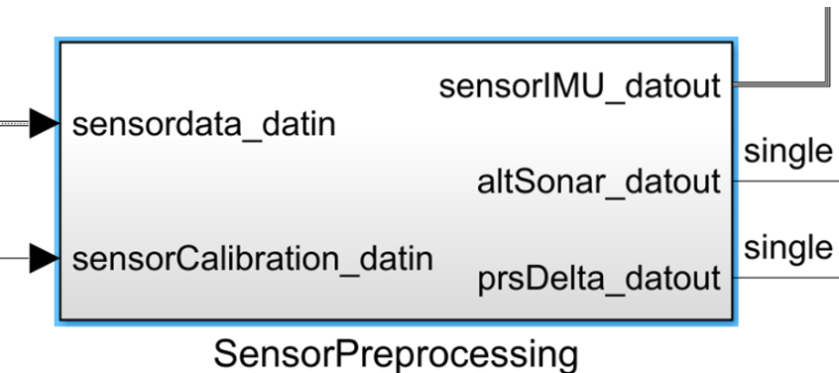
conclusion
What is IPR
conclusion
topic
Significance
about

Slide 17
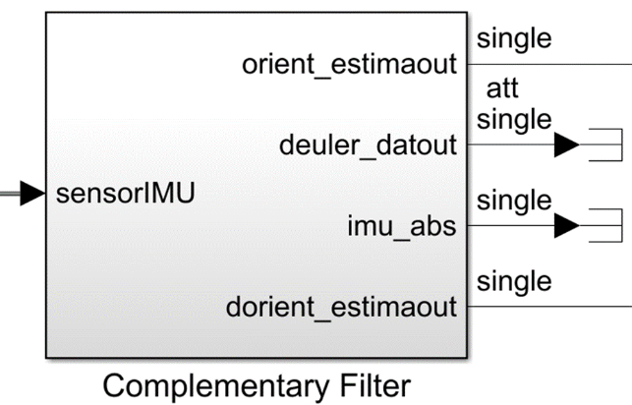
Commonly used filters :
Complementary Filter- It is used for estimation of altitude, roll,
pitch and yaw angles.
Kalman Filters- It is used for estimation of position and velocity.
conclusion
What is IPR
conclusion
topic
Significance
about

Slide 18
Learnings:
PID Controllers and its tuning
Image processing: Hough transform, vision based path following concepts, image Binarization
State Machine Diagram with the help of stateflow , Different sensors like accelerometer, barometer, gyrosensor , Magnetometer, IMU
Further scope of improvements:
-> There are some noise at the turnings of the path which can be eliminated i.e., it can be made more smooth.
-> It can be modelled to fly in an environment having obstacles in the form of buildings.
Conclusion
about
What is IPR
topic
materials
Conclusion

Slide 19
References:
-> Mathworks
-> Model-based Design of a Line-tracking Algorithm for a Low-cost Mini Drone
through Vision-based Control by PAOLO CEPPI
-> A Vision-Based Algorithm for a Path Following Problem by Terlizzi, Mario, and Silano,
Giuseppe and Russo, Luigi and Muhammad, Aatif and Basiri, Amin and Mariani,
Valerio and Iannelli, Luigi and Glielmo, Luigi, IEEE
-> ATL_Drone_Module - Get, Set, Fly! - Dr. Ayesha Chaudhary, Atal Innovation Mission,
NITI Aayog.
-> Wikipedia, Quora, Researchgate
References
working 1
materials
problem
project
about
Thank you for your time and patience.

